Slide 1
Speed Parkour
David Tsang
Blake Luo
TPS Parkour Game

Slide 2
Background
a person who is starting to play parkour. the player should help him to finish the level of different terrain.

Slide 3
Design

Slide 4
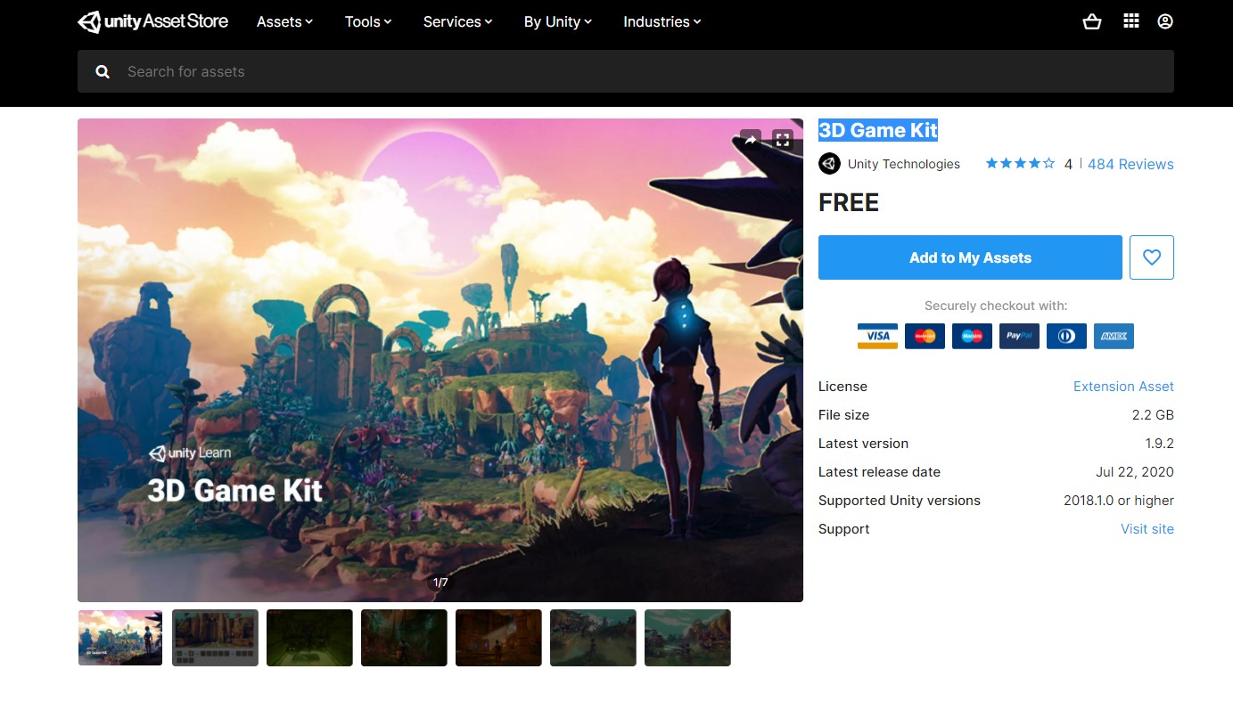
3D assets
All 3D assets are created by Blender
template assets is 3D Game Kit

Slide 5
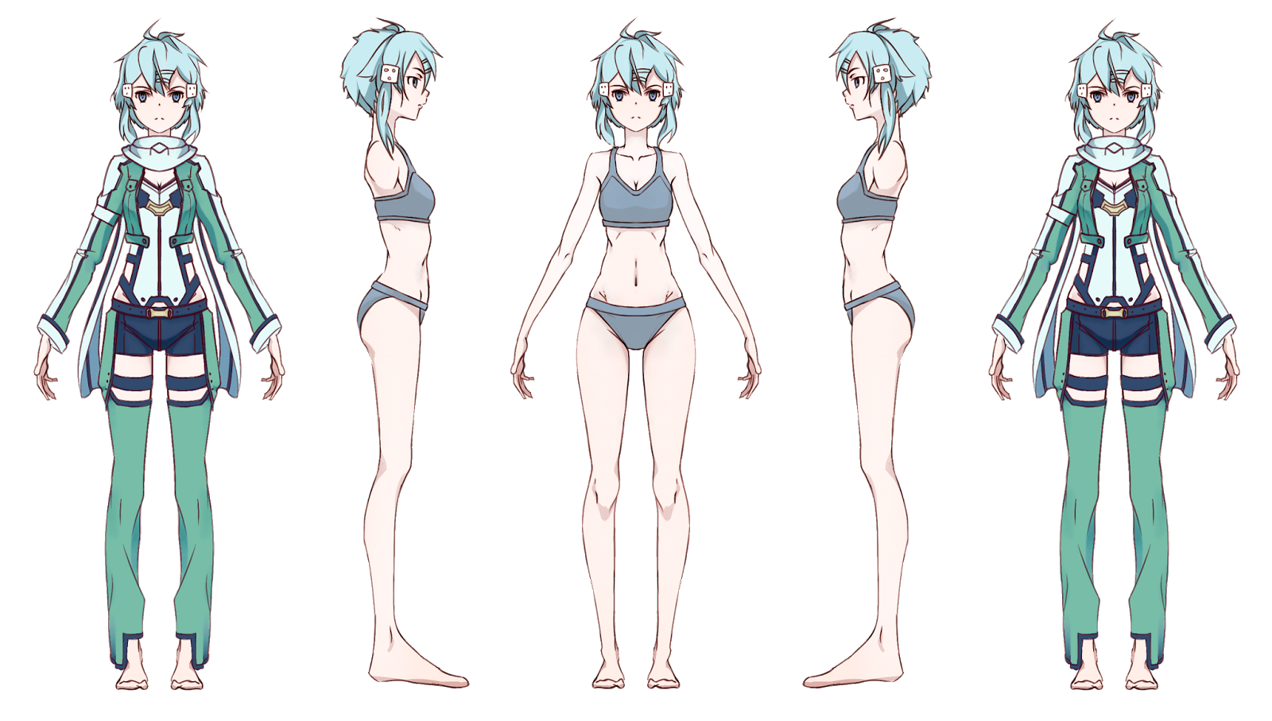
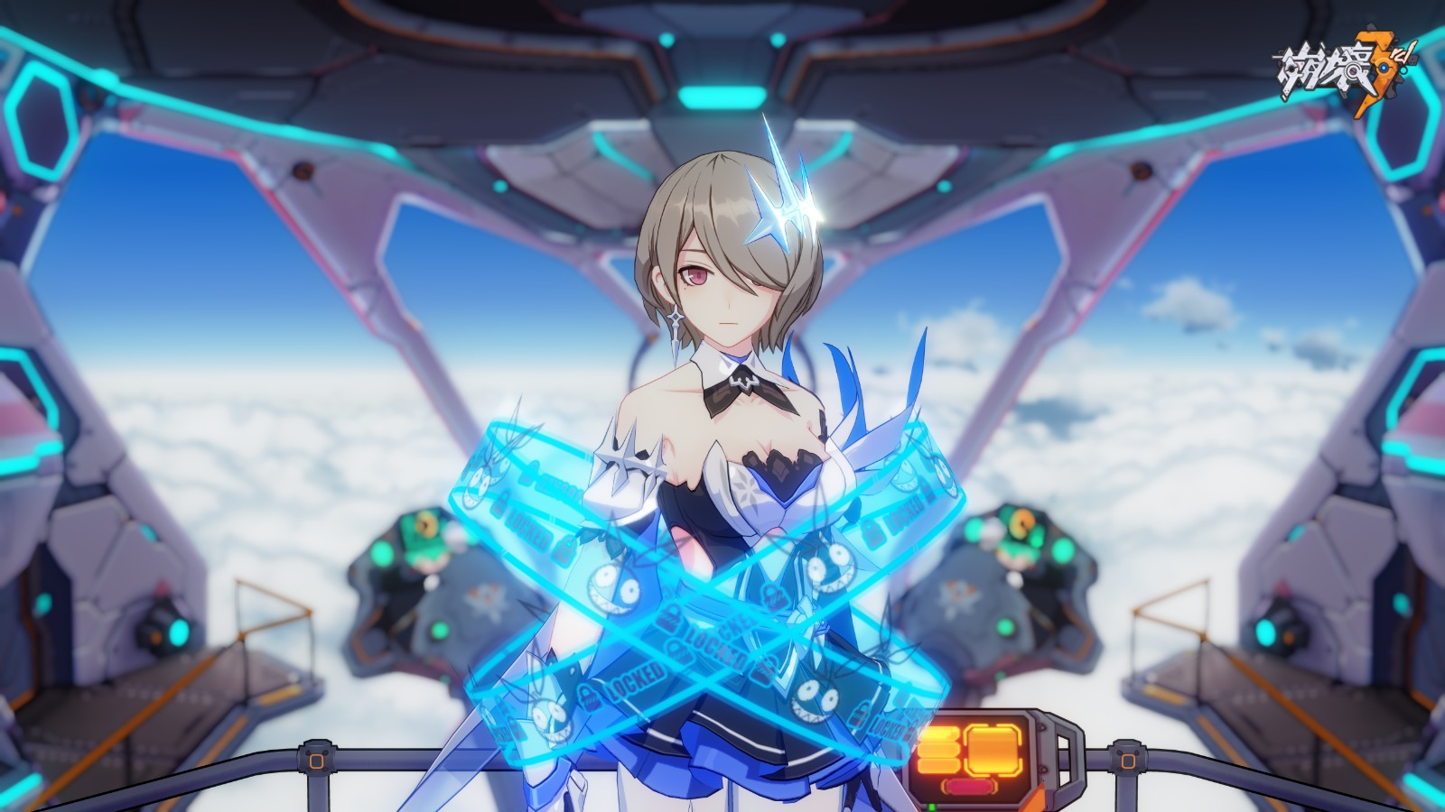
Model Reference

Slide 6
Game Play

Slide 7
Start

Slide 10
Menu

Slide 11
Comming Soon
New character model
One more harder levels
Terrian UPDATE(More Exterior Design)

